Slide 1

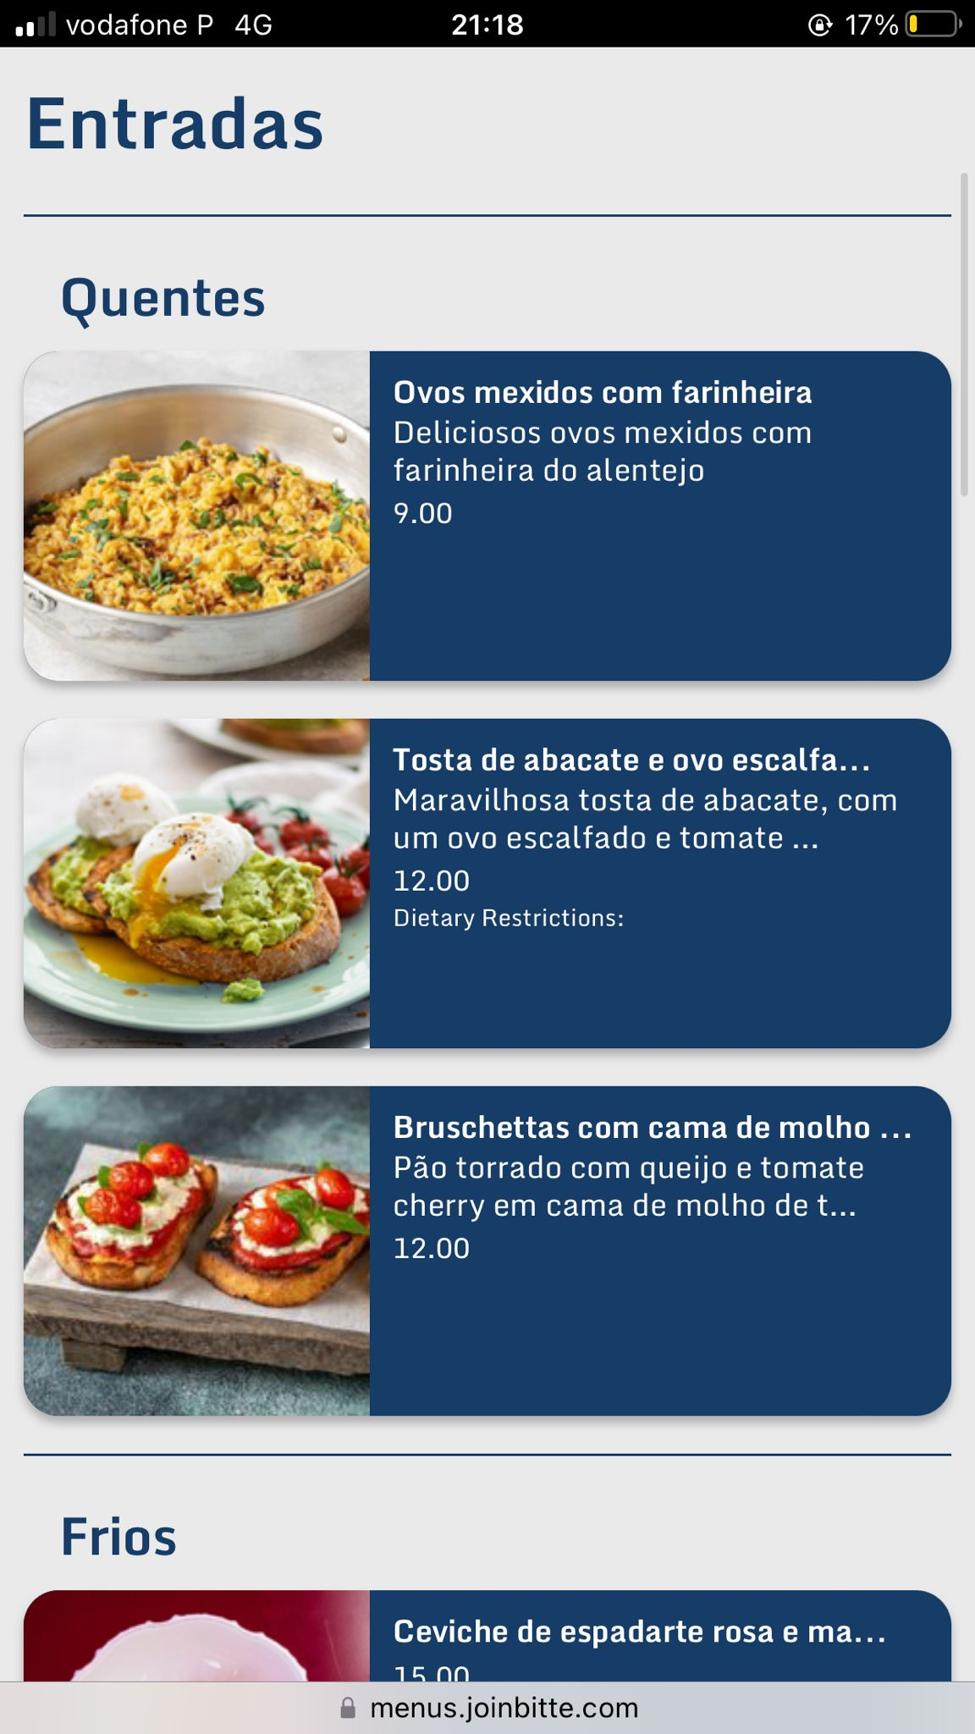
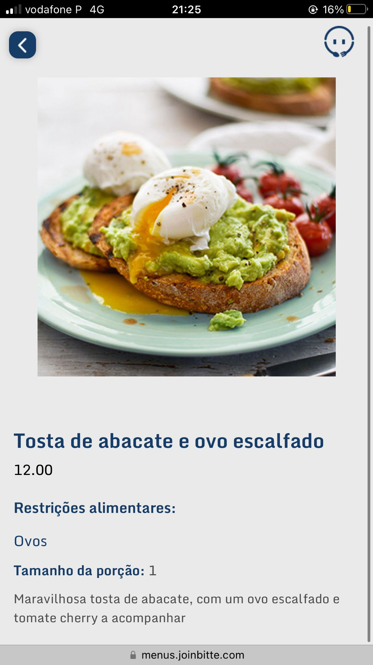
Menus made beautiful

Slide 2
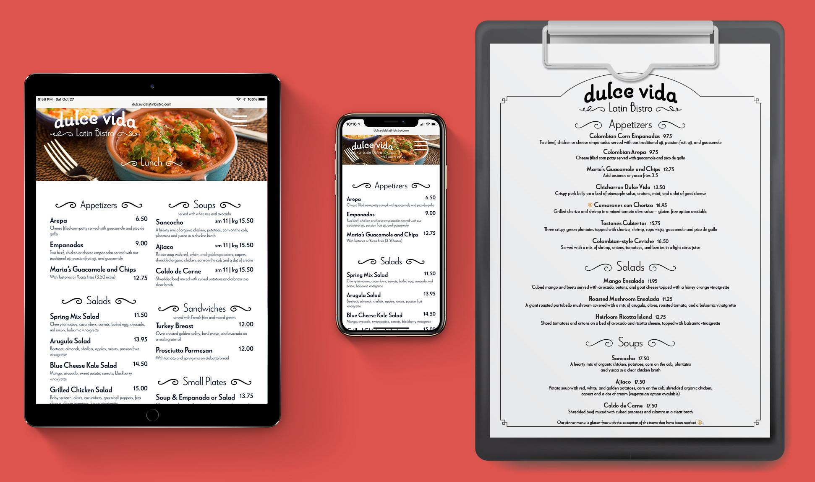
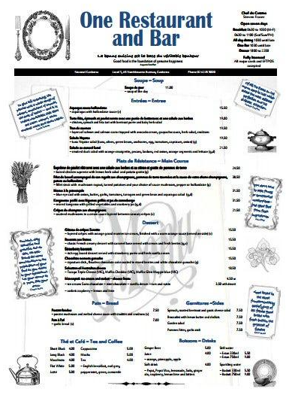
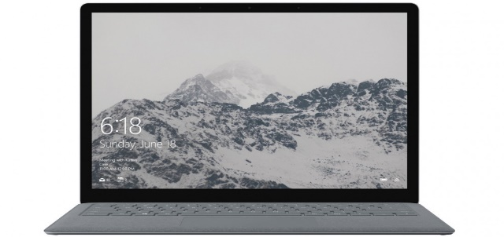

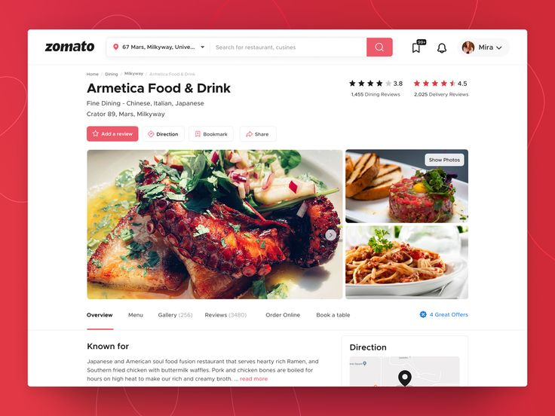
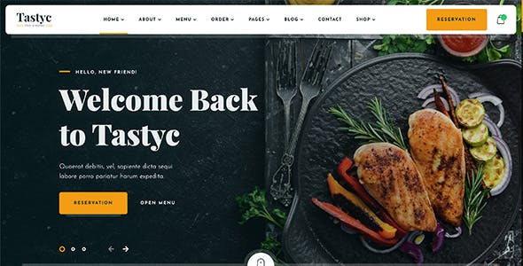
The menu is the face of a restaurant for the customers who visit it, but the alternatives available in digital format are unappealing.
Before the customer arrives at the restaurant
When the customer is in the restaurant
Option to view the menu
Menu photos taken by customers on TheFork, Google, etc.
Restaurant menu in own website
Digital menus on tablets from the restaurant
Menus digitais em PDF
disponíveis no telemóvel
Dependent on third parties Potentially outdated when the customer views Lack of interactivity
High initial investment Constant maintenance costs
Investment in tablets Need for software development and updating
Menu em PDF Unappealing design Lack of interactivity
Problems

Slide 3

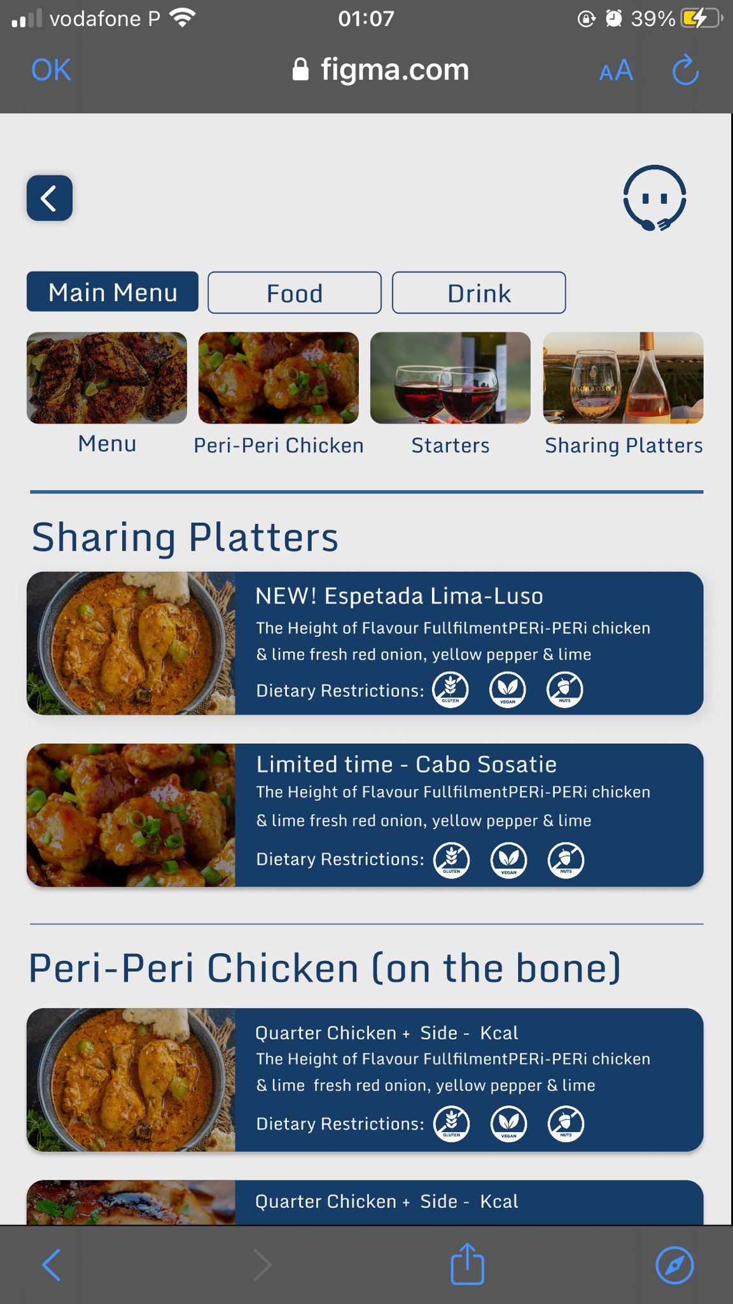

We will enter the market by solving this problem…
Bitte has developed a digital menu that aims to solve these problems. We will introduce you to some of the benefits that our solution offers to its users.
User experience and interactivity
Bitte allows the user a richer and more interactive experience with the restaurant. Our menus are ready to present not only the photographs or nutritional value of your dishes, but also to offer suggestions for combinations, promoting more sales.
Menu always available to customers
By using this product, you can have an online and constantly updated menu that can be consulted by your customers at any time. This menu can be shared via a link on your social networks, or with partners you work with, such as TheFork, Zomato, or others.
Appealing layout and adapted to the restaurant
Bitte offers different layouts, so you can use a template that fits the image of your restaurant and that conveys your brand image.
Financial efficiency
Studies show that the use of digital menus can lead to revenue increases, derived from the more visually appealing presentation or interactivity of the menu. At the same time, all this is achieved through a solution that does not require the level of investment of other alternatives, such as the menu on its own website or tablets in the restaurant.

Slide 4






…with so much more in our roadmap!
Our purpose
Vision: To provide innovative solutions in the restaurant industry, enabling restaurants to deliver exceptional customer experiences.
Mission: To improve the consumer experience in the restaurant industry, while improving operational efficiency and financial management.
What we offer
Digital menu
Digitalization of customer processes
Digitalization of restaurant processes
Management supported by Artificial Intelligence
Creation of appealing and interactive digital menus that allow restaurants to use an efficient and effective tool in communicating with their customers
Development of a product that allows the customer to interact with the restaurant in a digital way through their smartphone, to place orders, pay the bill, or make reservations.
Bet on the digitalization of internal processes, such as kitchen management, order queues or inventory management.
Use of Artificial Intelligence mechanisms that, based on the metrics and information collected and comparison with the best practices of the sector, indicate concrete actions that improve the management of the restaurant.

Slide 5



Business Model: 4 streams for growth and profit
Revenue streams – our revenue model will evolve whith the evolution of our product
Freemium – Free basic service with a subscription upselling
Payment Commissions - Bitte Transactions
Expanded services
Offer a basic version of the solution for free to attract a large user base. Collect and analyze data from these users to identify patterns, needs, and opportunities to upsell them to premium versions.
Introduce a tiered subscription model that allows restaurants to choose a package best suited to their scale and needs.
Generate revenue by taking a small commission from every transaction made using our digital platform.
Allow customers to book tables in restaurants that use the app, in exchange for a commission or fixed value (TBD based on market analysis)
Other services to be analyzed.
Timeline

Slide 6

Market Size
TAM: €7B BILLION
Estimated 10 million restaurants
times 700 euros per year on other tech solutions for restaurants
SAM: €1.5 BILLION
Of the 10 million restaurants, around 20% would be within reach.
SOM: €150 MILLION
Capturing 10% of the SAM would result in 150 million euros

Slide 7


What we accomplished so far and our next steps.
An MVP developed to analyze the market and collect feedback
12 Restaurants are using our MVP and 20 more are in production
A 30k funding to improve the product
To celebrate:
MVP phase 2
Go-to-market
Funding/incubation strategy definition
To go after

Slide 8


Founding team
PEDRO ALBUQUERQUE E CASTRO
DIOGO ALVES DE RESENDE
NTT Data
ex-Zalando
2.5 X failed entrepreneur
7 years of consulting
Unsuccessful YouTube creator
Instructor Partner at Udemy (top 0.3%)

